Slide 1

Introduction to Operations Security (OPSEC)
Updated 09/28/11
Security is Everyone's Responsibility – See Something, Say Something!

Slide 2
The following presentation on OPSEC was based off of an Air force briefing. Though the concept is primarily used throughout the military, it can be applied to all government agencies.
http://www.doc.gov/osy/wrso.html
Security is Everyone's Responsibility – See Something, Say Something!

Slide 3
Objective
Understand the core of Operations Security (OPSEC)
Define & identify targets and threats
Establish countermeasures
Identify the Critical Information Commandments
Decipher the value of information
Security is Everyone's Responsibility – See Something, Say Something!

Slide 4

What is OPSEC…?
Have you ever taken precautions against Someone…
    …breaking into your house while you’re on vacation?
    …stealing your purse?
    …stealing packages from your car while your shopping?
    …fraudulently using your credit card?
Then you have used OPSEC!
Security is Everyone's Responsibility – See Something, Say Something!

Slide 5
What is OPSEC…?
OPSEC is a risk management instrument that enables a manager or commander to view an operation or activity from the perspective of an adversary. It is a process of identifying, analyzing and controlling critical information.
Security is Everyone's Responsibility – See Something, Say Something!

Slide 6
What is OPSEC…?
Identify Critical Information
Analyze Threats
Discover Vulnerabilities
Assess Risks
Develop
Countermeasures
Spies
Foresight
Home
Privacy
Theft
Ops
Caution
Terror
Security is Everyone's Responsibility – See Something, Say Something!

Slide 7
What is OPSEC…?
Identify Critical Information:
    Credit card numbers, travel dates, itineraries, passwords, patterns, changes in patterns, inspection results, information base systems, etc..
Analyze Threat:
    Adversaries, Intelligence agencies – Open source information, corporate/state sponsored spies, eavesdropping, photographing, etc…
Security is Everyone's Responsibility – See Something, Say Something!

Slide 8
What is OPSEC…?
Discover Vulnerabilities:
    Flow of information, operations, timing of events, how an adversary would acquire the information, etc…
  How would the loss of such data impact the organization?
Assess Risks:
    Estimated loss $ x impact of risk x likelihood of risk = $
    Does the solution outweigh the loss?
Security is Everyone's Responsibility – See Something, Say Something!

Slide 9
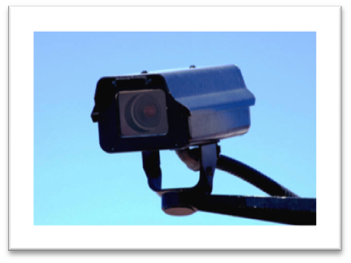
What is OPSEC…?
Develop Countermeasures:
      are based on the vulnerabilities and inherent risks.
    Are dictated by cost, timing, feasibility, and imagination of involved personnel. Simplicity, straightforwardness, and inexpensiveness are key to the most effective countermeasure solutions.
OPSEC is a DIFFERENT WAY of SEEING
Security is Everyone's Responsibility – See Something, Say Something!

Slide 10
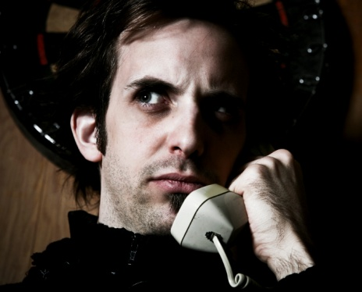
How Do I Identify Threats & Vulnerabilities…?
Take note of suspicious behavior
  HUMINT- “Task our students in the US with collecting information on the security of the facility where they are doing research. Then we’ll use one of our special teams to steal the chip.”
If you see something, say something
Be consistent with the testing of systems
      There is always room for improvement
Security is Everyone's Responsibility – See Something, Say Something!

Slide 11
Critical Information Commandments…
Thou must protect the information that the adversary needs to accomplish his mission.
Thou shall not try to protect everything.
Consider who thy adversaries are and what information they require to inflict harm to you.
Security is Everyone's Responsibility – See Something, Say Something!

Slide 12
Critical Information Commandments…
Thou shall consult all sources of information to determine what thine enemies know about you.
Once thou has determined what information is critical, thou shall determine if that information is associated with thine activities.
Security is Everyone's Responsibility – See Something, Say Something!

Slide 13

What Information Should I Protect…?
Information that the adversary needs to accomplish their mission.
Intelligence information on programs associations
Technical information on communications
Security is Everyone's Responsibility – See Something, Say Something!

Slide 14
What Information Should I Protect…?
Tactical information concerning intentions
Scientific information regarding new technologies
Military capabilities
Commercial information on new technologies
Security is Everyone's Responsibility – See Something, Say Something!

Slide 15
What Information Should I Protect…?
Military weapons’ information:
      Capabilities, manufactures, purpose, vulnerabilities, effectiveness, type, testing details, etc…
Scientific Industrial Information
      Technology & Research
      Technical specifications
      Marketing plans
      Key personnel
      Breakthroughs
Security is Everyone's Responsibility – See Something, Say Something!

Slide 16
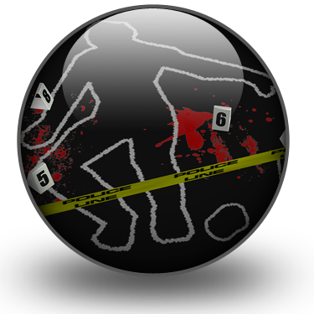
What Information Should I Protect…?
Law Enforcement plans & information sources
      Warrants, Witnesses, Evidence, Capabilities, Raids, Who, What, Where, How, etc…
Security is Everyone's Responsibility – See Something, Say Something!

Slide 17
Conclusion…
OPSEC is critical to our National Security
Contact your Regional Security Officer for more information:
My Security Manager is?
Cheryl Wieser
206-526-6653
Security is Everyone's Responsibility – See Something, Say Something!

